Slide 1


Engineering Internship Presentation
Semi-supervised semantic segmentation
with High- and Low-Level Consistency
Elaborated by : Ines KOTTI
3rd Year Engineering Student
Supervised by : Mr. Nizar BOUGUILA - Professor at Concordia university
Mr. Vahid KHORASANI GHASSAB - Assistant professor
A.Y 2020 - 2021

Slide 2

Plan
1
1. Introduction
2. General Framework
3. Problem Modeling
4. Exploring Experimental Results
5. Conclusion
02

Slide 3
1. Introduction
2. General Framework
3. Problem Modeling
4. Exploring Experimental Results
5. Conclusion
INTRODUCTION
03

Slide 4
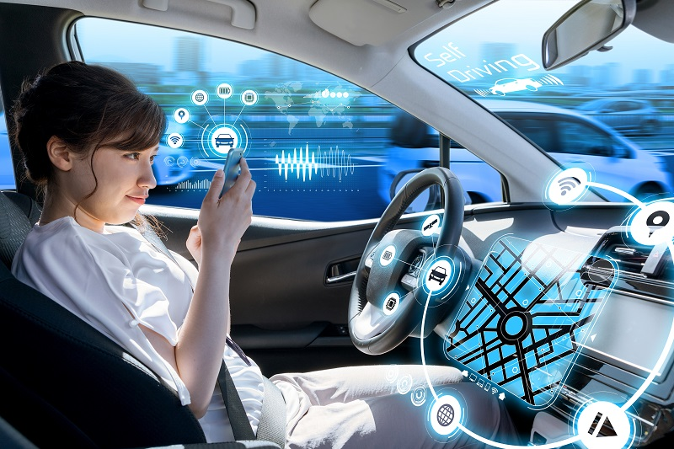
Automotive technologie
1. Introduction
2. General Framework
3. Problem Modeling
4. Exploring Experimental Results
5. Conclusion
The continuing evolution of automotive technology aims to deliver even greater safety benefits.
04
Notes:
The continuing evolution of automotive technology aims to deliver even greater safety benefits and automated driving systems that — one day — can handle the whole task of driving when we don’t want to or can’t do it ourselves. Fully automated cars and trucks that drive us, instead of us driving them, will become a reality.

Slide 5
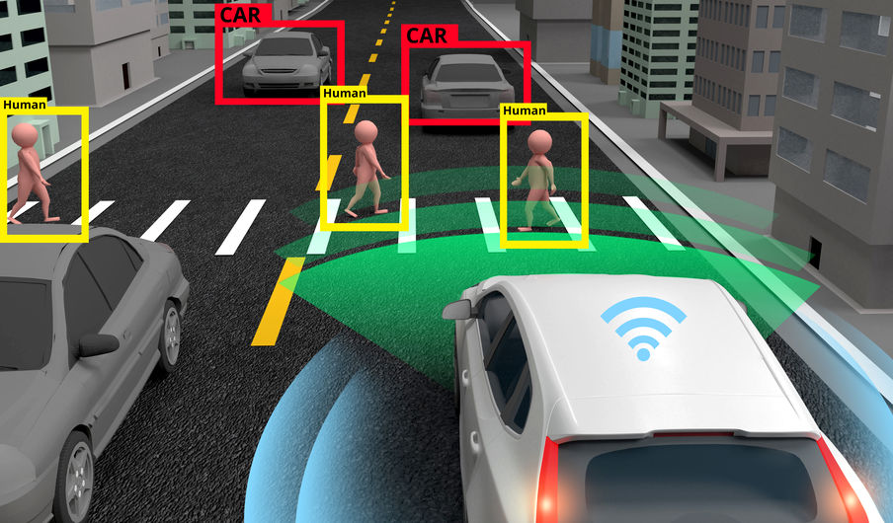
How do autonomous cars work ?
1. Introduction
2. General Framework
3. Problem Modeling
4. Exploring Experimental Results
5. Conclusion
05
Notes:
This car rely on sensors, complexe algorithms, machine learning systems and video camera to detect traffic lights, read road signs etc…
Semantic segmentation is one of the key computer vision tasks in various applications including autonomous driving.

Slide 6
1. Introduction
2. General Framework
3. Problem Modeling
4. Exploring Experimental Results
5. Conclusion
General Framework

Slide 7
Problem Statement
Problem statement
High-Level
error
Low-Level
error
1. Introduction
2. General Framework
3. Problem Modeling
4. Exploring Experimental Results
5. Conclusion
Notes:
Deep convolutional neural networks have demonstrated great results on this task. But, it is a sophisticated process that involves much manual efforts.
Our work is how to deal with low level : that gives us a wrong object shapes, inaccurate boundaries and incoherent surfaces.
High: which leads to assigning large image regions to wrong classes.

Slide 8
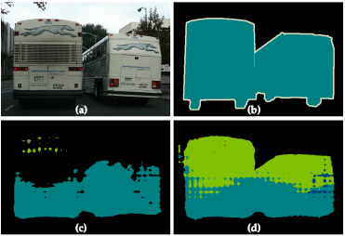
1. Introduction
2. General Framework
3. Problem Modeling
4. Exploring Experimental Results
5. Conclusion
(c) : Low level error : appears as inaccuracy in low-level details, such as wrong object shapes, inaccurate boundaries, and incoherent surfaces.
(d) : High level error : leads to assigning large image regions to wrong classes.

Slide 9
High-Level error
=>
Project Goals
1. Introduction
2. General Framework
3. Problem Modeling
4. Exploring Experimental Results
5. Conclusion
Low-Level error
=>
MLMT Branch
GAN4s
09
Notes:
To alleviate this two type of error, we have worked on two network brunches designed seperately address.
Propose / acts as a generator

Slide 10
1. Introduction
2. General Framework
3. Problem Modeling
4. Exploring Experimental Results
5. Conclusion
Problem Modeling

Slide 11




Python packages
1. Introduction
2. General Framework
3. Problem Modeling
4. Exploring Experimental Results
5. Conclusion
11

Slide 12
Dataset
Cityscape dataset
2,975 used to train the model
500 used for validation
1,525 used to test the model
1. Introduction
2. General Framework
3. Problem Modeling
4. Exploring Experimental Results
5. Conclusion
12

Slide 13
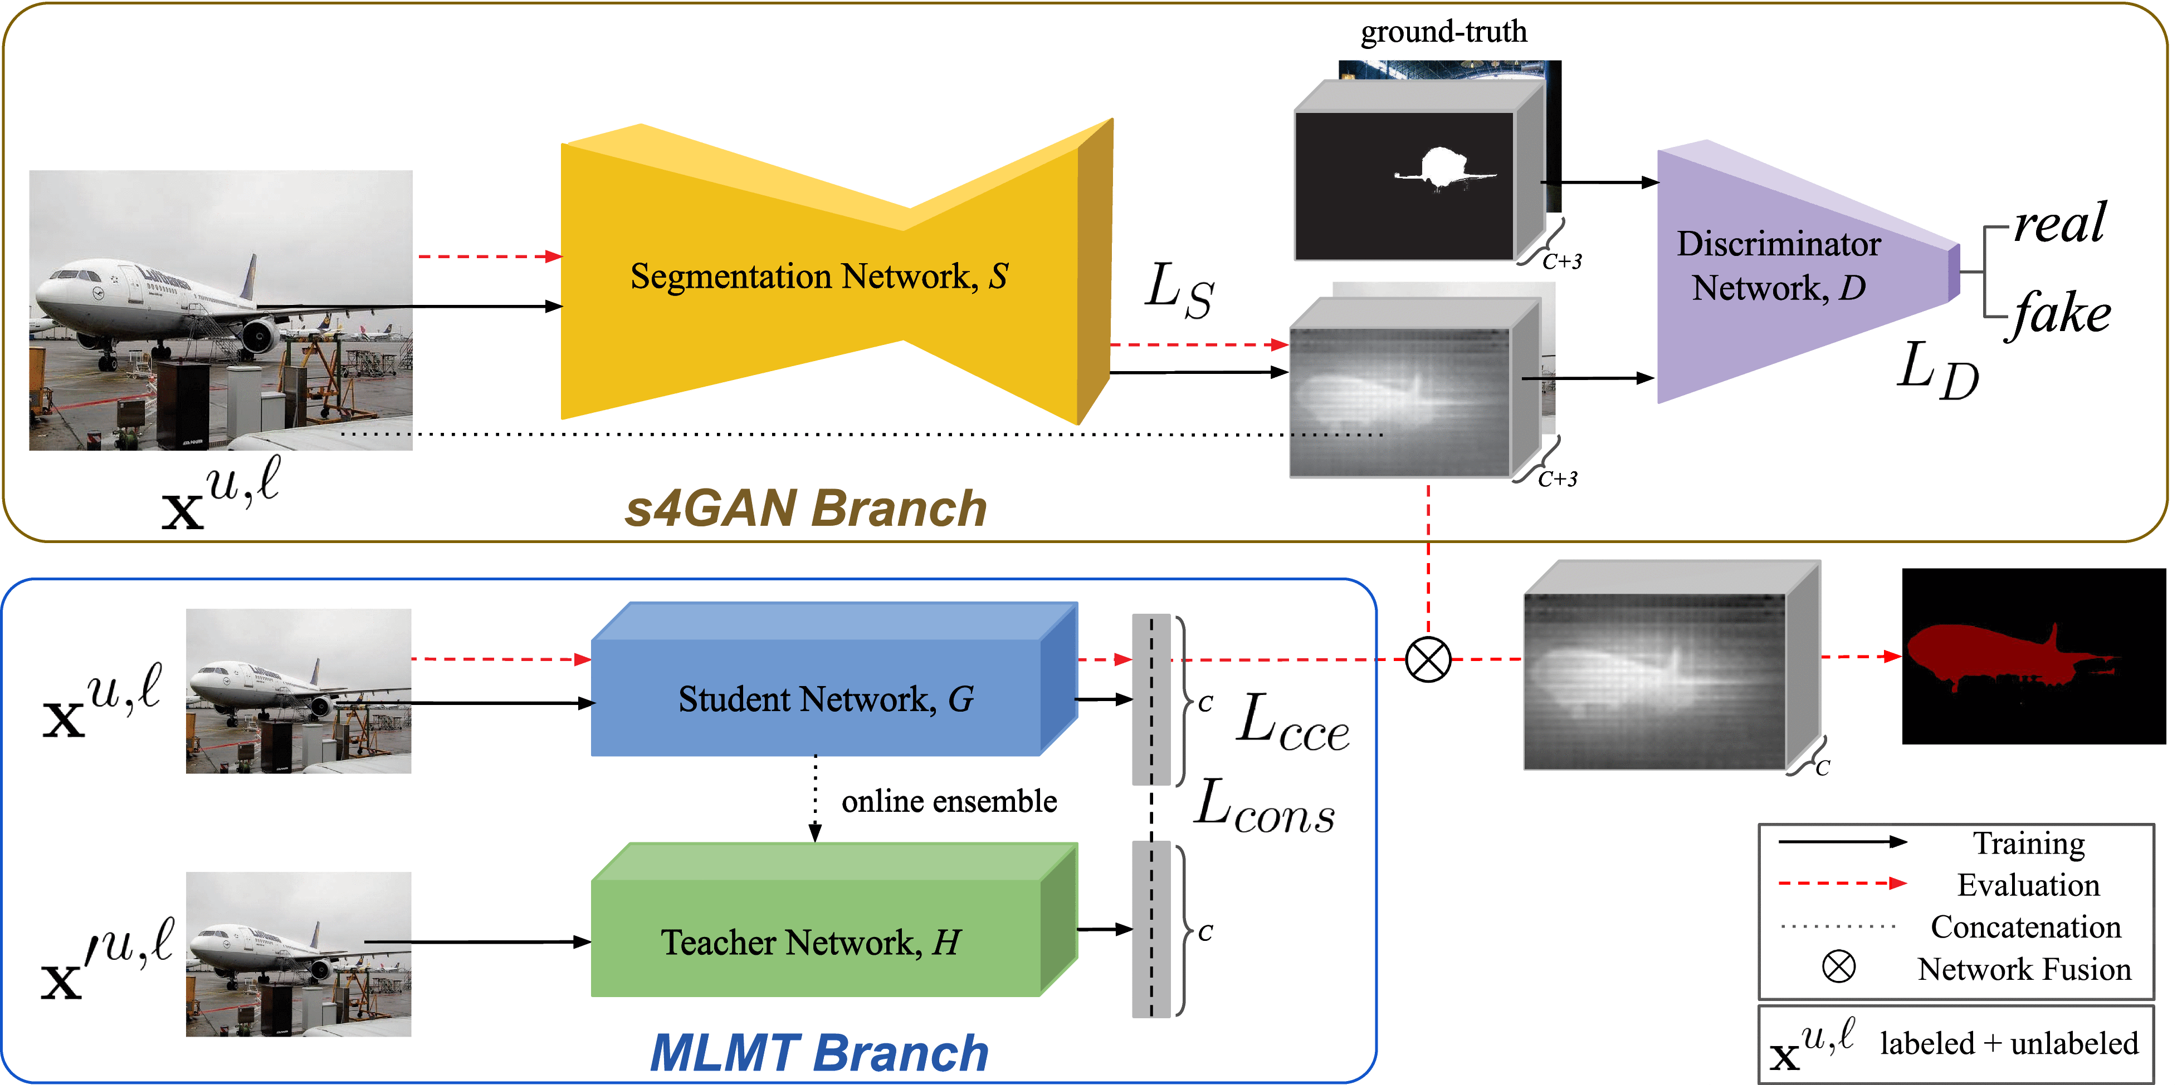
Overview of our proposed semi-supervised segmentation approach
1. Introduction
2. General Framework
3. Problem Modeling
4. Exploring Experimental Results
5. Conclusion
13

Slide 14
Semantic segmentation
Employed Architecture
1. Introduction
2. General Framework
3. Problem Modeling
4. Exploring Experimental Results
5. Conclusion
14

Slide 15
Discriminator Architecture
Employed Architecture
1. Introduction
2. General Framework
3. Problem Modeling
4. Exploring Experimental Results
5. Conclusion
Layer (type) | Output Shape
Conv2d-1 | [-1, 64, 161, 396]
LeakyReLU-2 | [-1, 64, 161, 396]
Dropout2d-3 | [-1, 64, 161, 396]
Conv2d-4 | [-1, 128, 80, 198]
LeakyReLU-5 | [-1, 128, 80, 198]
Dropout2d-6 | [-1, 128, 80, 198]
Conv2d-7 | [-1, 256, 40, 99]
LeakyReLU-8 | [-1, 256, 40, 99]
Dropout2d-9 | [-1, 256, 40, 99]
Conv2d-10 | [-1, 512, 20, 49]
LeakyReLU-11 | [-1, 512, 20, 49]
AvgPool2d-12 | [-1, 512, 1, 1]
Linear-13 | [-1, 1]
Sigmoid-14 | [-1, 1]
15

Slide 16
Train the discriminator with real image and fake image.
The segmentation network takes images.
The segmentation predicts segmentation maps.
concatenate input of the original image and its corresponding predicted segmentation.
The discriminator take the concatination images.
The discriminator predict if it is fake or real.
update the segmentation network with the output of the discriminator.
1. Introduction
2. General Framework
3. Problem Modeling
4. Exploring Experimental Results
5. Conclusion
16

Slide 17
mean teacher architecture
1. Introduction
2. General Framework
3. Problem Modeling
4. Exploring Experimental Results
5. Conclusion
17

Slide 18
1. Introduction
2. General Framework
3. Problem Modeling
4. Exploring Experimental Results
5. Conclusion
Exploring Experimental
Results

Slide 19
GAN4s Branch
1. Introduction
2. General Framework
3. Problem Modeling
4. Exploring Experimental Results
5. Conclusion
Original Image
Labeled Image
Generated Image
19

Slide 20
Metric
Find the frequency number of each class for both matrices.
Convert the matrix to 1D format.
Construct the confusion matrix.
Calculate IoU for individual classes.
Calculate MIoU for the actual-predicted pair.
Find out the category matrix.
1. Introduction
2. General Framework
3. Problem Modeling
4. Exploring Experimental Results
5. Conclusion
20

Slide 21
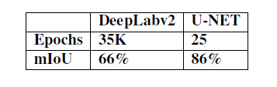
1. Introduction
2. General Framework
3. Problem Modeling
4. Exploring Experimental Results
5. Conclusion
the approach works well for labeled data.
both U-NET and DeepLabv2 models produce false positives, predicting incorrect class labels even with full data annotation.
21

Slide 22
MLMT Branch
1. Introduction
2. General Framework
3. Problem Modeling
4. Exploring Experimental Results
5. Conclusion
=> we don't have a more optimized version which has to take into consideration all the objects in the image.
22

Slide 23
1. Introduction
2. General Framework
3. Problem Modeling
4. Exploring Experimental Results
5. Conclusion
Conclusion

Slide 24
Conclusion
1. Introduction
2. General Framework
3. Problem Modeling
4. Exploring Experimental Results
5. Conclusion
Dense pixel-level classification with limited data is not an easy task.
The results we have received are insufficient, but quite acceptable.
24

Slide 25
Future perspectives
1. Introduction
2. General Framework
3. Problem Modeling
4. Exploring Experimental Results
5. Conclusion
A fusion of spatial and class information to remove false positive class channels.
Enhance quality of results.
25

Slide 26
Thank You for your attention

